Slide 1
2024-26 NFHS girls gymnastics Rules PowerPoint
Rules Changes
Major Editorial Changes
Points of Emphasis

Slide 2
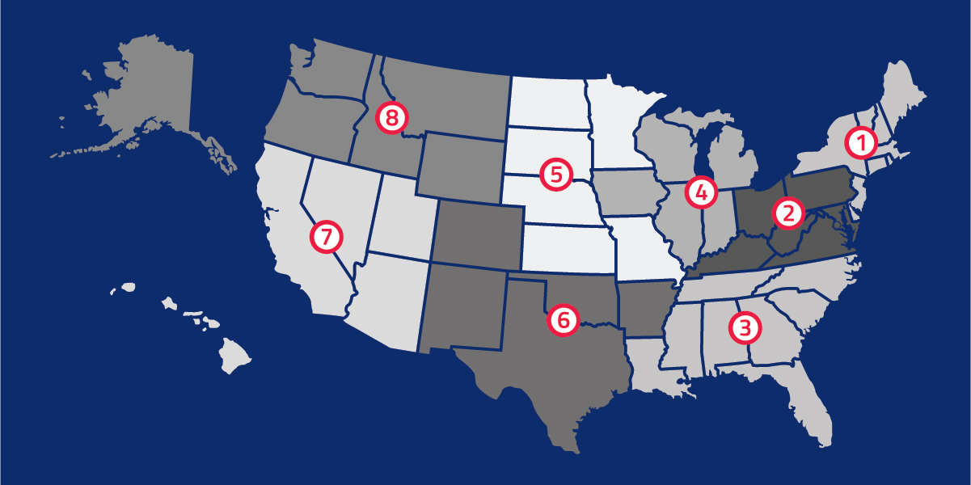
National Federation of
State High School Associations
NFHS (located in Indianapolis, IN – Est. 1920):
  National leader and advocate for
  high school athletics and
  performing arts programs.
  Serves 51 state associations, 19,500
  high schools and 12 million student
  participants.
  Writes playing rules for 17 high school
  sports for boys and girls.
  Offers online education courses for high school coaches,
  officials, parents, students and others.
  Ensures that students have opportunity to enjoy healthy participation, achievement and good sportsmanship in education-based athletics.
Notes:
The NFHS is the national leader and advocate for high school athletics and performing arts programs. Services of the NFHS reach more than 19,500 high schools and 12 million participants throughout the eight NFHS sections across the U.S.
A significant responsibility of the NFHS is the commitment to writing quality playing rules for 17 high school sports for boys and girls, in addition to providing educational resources for high school coaches, officials, parents and students.
It is the vision of the NFHS to help prepare tomorrow’s leaders for the next level of life through the many program offerings in education-based athletics and activities.

Slide 3








NFHS Rules Review Committee
The NFHS Rules Review Committee is chaired by the chief operating officer and composed of all rules editors. After each committee concludes its deliberations and has adopted its recommended changes for the subsequent year, such revisions will be evaluated by the Rules Review Committee.
Davis Whitfield
Chief Operating Officer
Lindsey Atkinson
Basketball, Girls Lacrosse and Volleyball
Bob Colgate
Football and Sports
Medicine
Sandy Searcy
Softball, Swimming & Diving and Water Polo
Elliot Hopkins
Baseball and Wrestling
Julie Cochran
Cross Country, Gymnastics, Field Hockey, Soccer and
Track & Field
James Weaver
Boys Lacrosse
and Spirit
Dan Schuster
Ice Hockey
Notes:
The rules writing process is multi-tiered. Each year, specific committee meets to deliberate rules proposals submitted by state associations and committee members. After each committee concludes its deliberations and has adopted its recommended changes for the subsequent year, proposals are sent to the Rules Review Committee, who then evaluates the proposals and then forwards the to the NFHS Board of Directors for their consideration. The NFHS Rules Review Committee is chaired by the chief operating officer and consists of all NFHS rules editors

Slide 4











NFHS Rules Committee
Dr. Karissa Niehoff
NFHS
Publisher
Julie Cochran
NFHS
Editor
Kathy Krebs
Crete, IL
Consultant
Stephanie Hauser
Stevens Point, WI
Chair- 2024
Dr. Kimberly Longobucco
Newton, CT
Section 1 - 2026
Kelley Haney
Charlottesville, VA
Section 2, 3 - 2026
Janie Ulmer
Indianapolis, IN
Section 4 - 2030
Sue Hamre
Sioux Falls, SD
Section 5 - 2030
Monique Lamphiere-Tamayoshi
San Diego, CA
Section 6,7,8- 2026
Steve Cunningham
Atlanta, GA
NFCA (1-5) - 2030
Jo-Di Tapia
Brighton, CO
NFOA (1-5) - 2024
Notes:
The 2024 Gymnastics Rules committee members. Representation of sections, the NFHS Officials Association, the NFHS Coaches Association, and Rules Committee Chair.

Slide 5





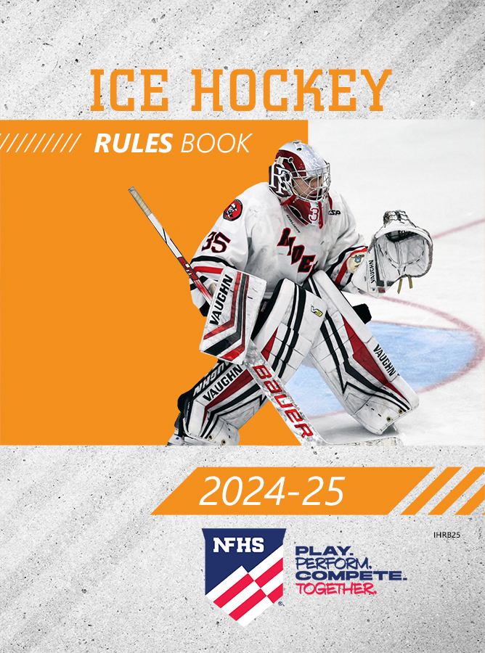

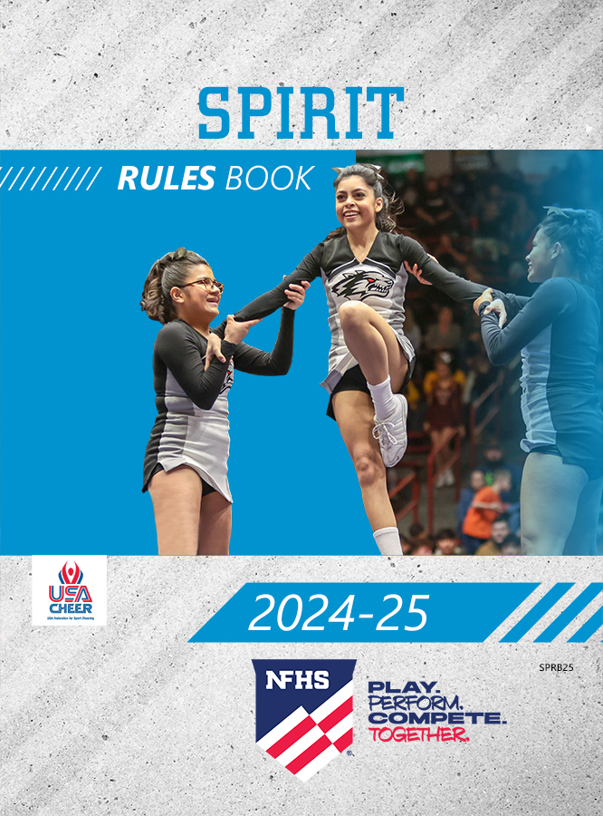


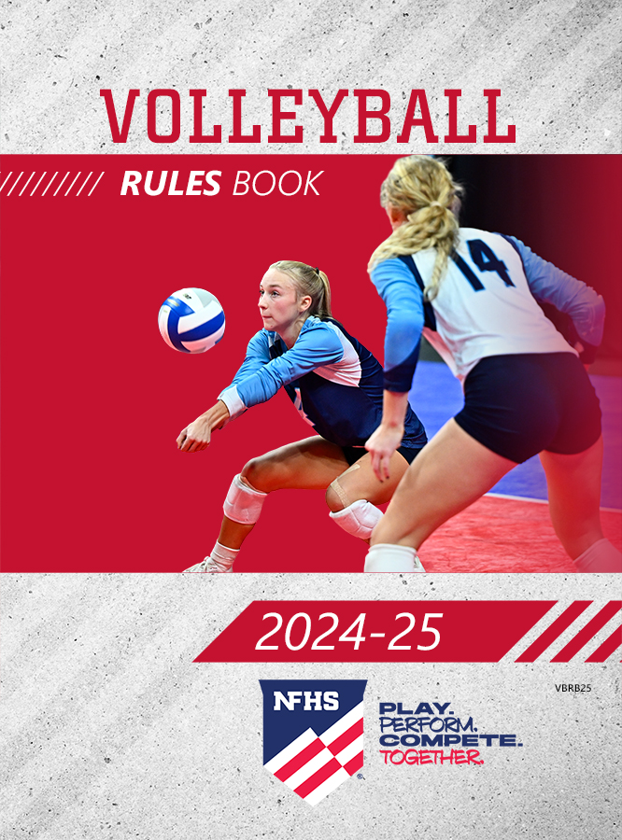
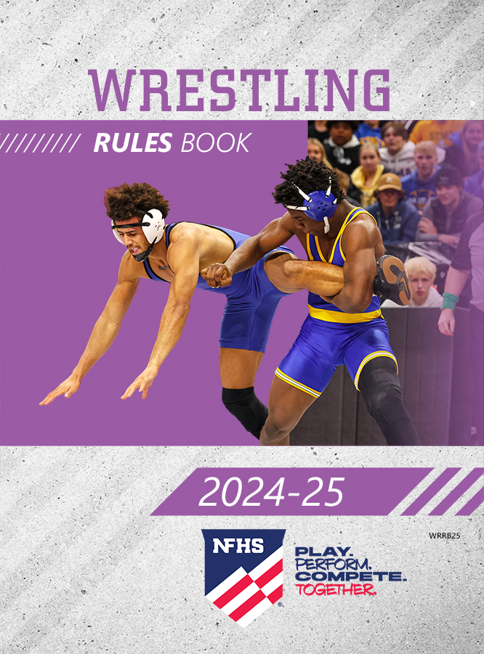





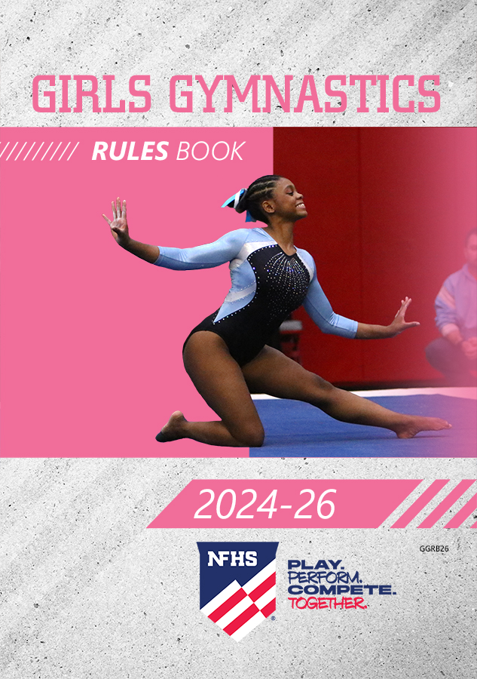
NFHS Publications
The NFHS writes playing rules for 17 sports
for boys and girls at the high school level.
  Publishes 4 million pieces of materials annually.
Notes:
The NFHS writes playing rules for 17 sports for boys and girls at the high school level and publishes 4 million pieces of materials annually.

Slide 6
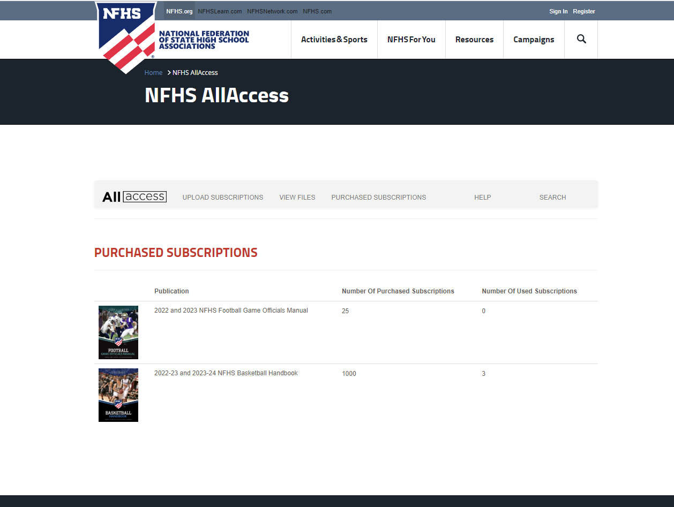
NFHS AllAccess – Website
AllAccess is the NFHS Digital Publications Platform that includes:
  Rules Publications
  High School Today Magazine
  Policy Debate Quarterlies
  Other NFHS Digital Publications
Website organized for associations and individuals to assign books and manage purchases
Visit https://allaccess.nfhs.org
Notes:
AllAccess is the New NFHS Digital Publications Platform that includes:
Rules Publications
High School Today Magazine
Policy Debate Quarterlies
Other NFHS Digital Publications
Website organized for associations and individuals to assign books and manage purchases
Visit www.allaccess.nfhs.org

Slide 7



NFHS AllAccess – Mobile App
Access Via Website or Mobile App:
View available publications for sale
View publications assigned to you
Download books for offline viewing
Read publications as an e-book
Available on App Store and Google Play
Notes:
Access Via Website or Mobile App:
View available publications for sale
View publications assigned to you
Download books for offline viewing
Read publications as an e-book
Book features include:
Table of contents
Highlighting text
Creating ‘sticky notes’ on pages
Searching for terms
Mark-up pen feature
Viewing highlights and notes on data page
Available on App Store and Google Play

Slide 8
Corrections to 2024-2026 Girls Gymnastics rules book
P. 26: Change current 2.405 to 2.502 (1/1 - 1/1) 10.0
P. 26: Change current 2.502 to 2.503 (1/1 on - 1 ½ off) 10.0
P. 26: Change current 2.503 to 2.504 (1/2 on – 2/1 off) 10.0
P. 28: Change current 4.501 (Tsukahara tucked with ½ twist) to 10.0
P. 31: 6.4.4 Situation, second line—”The judge deducts up to 0.30…”
P. 33: Event Requirements - Art. 4b “360°” (add degree sign)
P. 60: 8-3-3 (1) Lack of variety of acro and dance “up to 0.20”
P. 70 & 71: 2.306d, 2.407d 2.408d are new and should be shaded
P. 88: 9-3-4a - New 13—Add “Small or medium steps on landing (maximum of 4 steps)….each 0.10-0.15 max. 0.40”

Slide 9
Corrections to 2024-2026 Girls Gymnastics rules book
P. 88: 9-3-4c (3) – Squat on landing ( “hips even with or lower than the knees”)
P. 93: 1.306 – Should read “split lp/jp 180° w 1/1”
P. 94: 1.312 – should read “ stag ring jp w/ 1/1”
P. 107: 9.3.7 Situation A – last line “…a chief judge deduction of 0.30”
P. 107: 1.312 – should read “stag ring jump w/ 1/1 at head height”
P. 109: 5e Steps – delete the second indented description - ”The gymnast lands with feet together, then takes… join the Right foot.”
P. 115: 27, Floor Exercise a), 3) should read – “A 0.3 deduction…”
P. 115: 27, Floor Exercise a), 4) should read - “ A 0.8 deduction is taken…(0.3 for…”

Slide 10
2024-2026 nfhs girls gymnastics RULES CHANGES

Slide 11
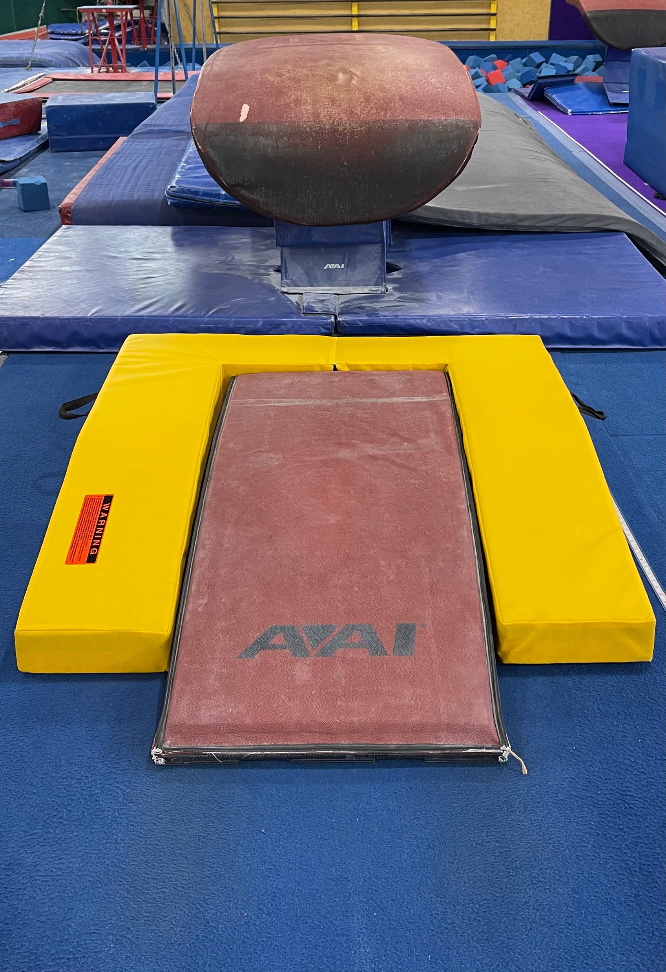
Rule 1 – definitions – safety zone mat
When the safety zone mat is used it shall be placed against the sides and front of the board.
Notes:
The purpose of the safety zone mat is to protect the gymnast if they hit the board off-center toward the front edge or the sides.
The picture illustrates the proper positioning of the safety zone mat with the safety zone placed against the front edge and sides of the board.

Slide 12
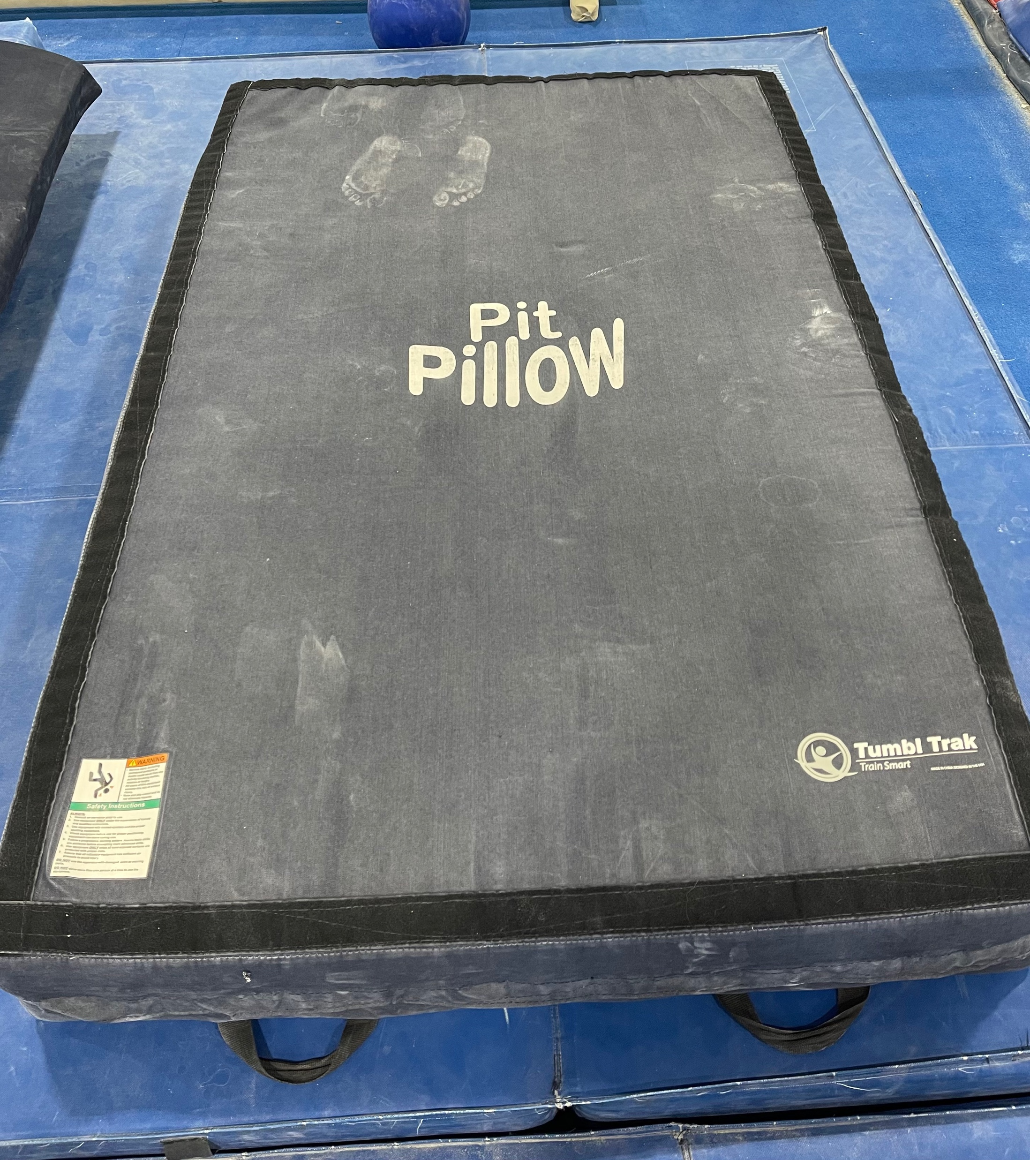
Rule 6-1-2J, 7-1-2h: Vault & Uneven Bar equipment
An alternate skill cushion made of softer foam (maximum of 4 feet x 6 feet x 8 inches) may only be used for timers during warm-ups for salto vaults.
Is allowed for bar releases only and must be removed immediately.
May not be used as a landing mat or for any other purpose on any apparatus.
Notes:
An alternate skill cushion made of softer foam (maximum of 4 feet x 6 feet x 8 inches).
May be used for timers during warm-ups only for salto vaults.
The Pit Pillow is allowed for bar releases only and must be immediately removed.
The Pit Pillow may not be used as a landing mat or for any other purpose on any apparatus.

Slide 13
Rule 2-1-4: Officials
No official shall use any form of alcohol or tobacco, or be under the influence of (i.e., impaired by) a controlled or illicit substance(s), beginning with arrival at the competition site until departure following the completion of the meet.
Notes:
This is the standard language that is used in all of the NFHS rules books.
It emphasizes that the use of alcohol, tobacco, or the use of illicit substance(s) is prohibited from arrival until departure at the competition site.

Slide 14
Rule 2-2-1b (9): equipment failure or interference
If there is equipment failure or interference beyond the control of the gymnast, the gymnast may stop immediately and request permission from the chief judge to continue from the point of interruption after the problem is corrected.
On floor exercise, the gymnast may choose to complete the routine and then decide whether to resume the routine at the point of the music failure or accept the score given. The score will not be flashed until a decision is made.
  if the decision is to accept the score, no deduction for music failure shall be taken
If problem was due to the responsibility of the gymnast, the gymnast may leave the equipment to fix the problem and then remount to continue the routine.
  the gymnast will receive a 0.50 deduction for leaving the apparatus before the end of the routine either intentionally or due to a fall
  the gymnast has 45 seconds to correct the problem and remount the apparatus
Notes:
The rationale for adding specific language to the rules book for repeating a routine is to clarify which part of the routine may be repeated and the circumstances that caused the need for a repetition.
Equipment failure or interference beyond the control of the gymnast, such as the cable on the uneven bars breaking, or a power failure during a floor exercise routine are circumstances that may allow for the gymnast to repeat a portion of her routine.
Failure to tighten the spin lock on the bars or turning the music up so loud that the speaker is unable to handle the amplification of the music are not equipment failures or interferences beyond the control of the gymnast. A coach pulling the plug on the music is not interference.
When the equipment failure has been corrected the gymnast may restart her routine from the point of interruption.
The entire routine may not be repeated.
All deductions that happened prior to the equipment failure/interference will remain and be calculated into the final score.
On floor exercise, a gymnast will frequently continue the routine until its conclusion when there is music failure.
The gymnast must then decide if she will accept the score of the first routine or if she wants to repeat that portion of the routine that was affected by the music failure.
If the first routine’s score is the one the gymnast accepts, no deduction is taken for music failure.
The score of the first routine when the interference occurred will not be flashed until the gymnast decides whether to accept that score or repeat her routine from the point of interruption.

Slide 15
Rule 2-2b (10), 6-5-2e, 7-3-7f, 8-3-7g, 9-3-7g: Improper uniform warning
The chief judge issues a warning to the coach of the improper uniform so the gymnast has the opportunity to correct the improper uniform prior to competing on the next event.
If the uniform violation is not corrected before competing on the next event, the chief judge deducts 0.20 from the average score.
This deduction is taken only one time during the meet.
Notes:
The chief judge issues a warning to the coach of the improper uniform so the gymnast has the opportunity to correct the improper uniform prior to competing on the next event.
If the uniform is not corrected before competing on the next event, the chief judge deducts 0.20 from the average score.
The deduction is taken only once during the competition.

Slide 16
Rule 3-3-4b: Earrings
Jewelry is prohibited.
  religious medals and medical alert medals are not considered jewelry but shall be taped to the body.
EXCEPTION: Athletes may wear stud earrings not to exceed one per ear.
Other body piercings are not allowed.
Notes:
Jewelry is prohibited.
Religious medals and medical alert medals are not considered jewelry but must be taped to the body.
Beginning with the 2024 – 2025 school year, one pair of stud earrings not to exceed one per ear are acceptable.

Slide 17
Rule 4-1-2E (3): Back-to-back Superior credit
A single element in a series may be counted twice to receive BBS credit.
In a direct connection of three or more elements, the second element in the series may be used twice when awarding BBS credit.
  in a series of three, the middle element may be connected to the first element in the series for BBS credit in Bonus
  the middle element may also be connected to the third element in the series for BBS credit in Bonus
Notes:
It is now possible to earn two back-to-back superior credit in Bonus with only three superiors, high superiors, or advanced high superiors.
This new rule applies only to back-to-back superior credit.
It does not apply to series requirements.
In a direct connection of three or more elements, the middle element can be used twice for back-to-back superior credit.
To receive credit for the first back-to-back superior the second element is connected to the first element in the series.
To receive credit for the second back-to-back superior, the second element is connected to the third element in the series.

Slide 18
Rule 4-1-2E (3): Back-to-back Superior credit examples
UB Example ➞ long hang kip, long hang kip, giant, layout flyaway dismount
  S + S + HS + HS
  LL BBS LL BBS HL BBS
BB Example ➞ back handspring, back handspring, layout back dismount
S + S + S
LL BBS LL BBS
FX Example ➞ aerial round-off, flic flac, flic flac, salto backward w/ full twist
S + S + HS
LL BBS LL BBS
Notes:
The first example on bars illustrates that a long hang kip directly connected to another long hang kip, is a low level back-to-back superior and the second long hang kip is directly connected to the giant for a second low level back-to-back superior. The giant is also connected to a layout flyaway which is a high level back-to-back superior.
The uneven bar example illustrates that the second element in the series can be used with the first element in the series for one low level back-to-back superior in bonus. The second superior may also be connected with the high superior for a second low level back-to-back superior in bonus. Finally, the high superior is connected to the dismount which is a high superior for a high level back-to-back superior.
The beam example illustrates that 3 superiors connected together without a pause or stop can earn credit for 2 low level back-to-back superiors in Bonus.
The floor example illustrates that either superiors or high superiors can be connected for back-to-back superior credit in a direct connection.

Slide 19
Rule 4-1-2E (4b): Back-to-back superiors on beam
On beam only, when awarding BBS credit for a series that includes dance, the dance elements shall come from Groups 1, 2 or 3.
  dance balances and body waves may not be used
Notes:
On beam only, when awarding back-to-back superior credit for a series that includes dance, the dance elements shall come from Groups 1, 2 or 3.
Dance balances and body waves may not be used.

Slide 20
Rule 6-1-1e, 6-1-2F: vault--substances on the vault table and hand placement mat
The use of tape, chalk or other substance is not permitted on the vault table.
The use of tape is not permitted on the hand placement mat. Chalk may be used on the hand placement mat.
Notes:
The use of tape, chalk or other substance is not permitted on the vault table.
Substances that are placed on the table can cause a safety hazard. Chalk on the hands is permissible but other substances may not be used on the table.
The use of tape on the hand placement mat has been deemed hazardous because when the tape is removed from the hand placement mat, it can leave a sticky residue.
Chalk may be used on the hand placement mat.

Slide 21
Rule 6-1-2g, 6-1-2J: Vault equipment
6-1-2g: If the safety zone is used, it must be placed against the board.
6-1-2j: An alternative skill cushion made of softer foam, commonly referred to as a pit pillow may be used for ”timers” during warm-ups for salto vaults.
  pit pillows are 4 feet by 6 feet by 8 inches
  mats that do not meet those specifications are not allowed
  track and field mats such as a high jump mat or pole vault pit are not legal and may not be used
A pit pillow may only be used during warm-ups for timers for salto vaults. A pit pillow may not be used during competition.
  a pit pillow is not considered a landing mat and should not be used for feet first landings
Notes:
6-1-2g: If the safety zone is used, it must be placed against the board.
6-1-2j: An alternative skill cushion made of softer foam, commonly referred to as a pit pillow, may be used for ”timers” during warm-ups for salto vaults.
Pit pillows are 4 feet by 6 feet by 8 inches.
Mats that do not meet those specifications are not allowed.
Track and field mats such as a high jump mat or pole vault pit are not legal and may not be used.
A pit pillow may only be used during warm-ups for timers for salto vaults.
A pit pillow is not considered a landing mat and should not be used for feet first landings. It may not be used during competition.

Slide 22
Rule 6-2-1, 7-2-2, 8-2-1: Timing of falls on all events
Following a fall, the gymnast has 45 seconds to remount the apparatus.
If an injury occurs following a fall, the fall time begins when the gymnast is standing on the feet and medical assessment is complete.
During the 45 second fall time, a warning is given at 30 seconds “15 seconds remaining.”
On vault, this procedure is followed when a fall occurs on the first vault.
On vault, bars and beam when the gymnast is standing on the feet and medical assessment is complete, the gymnast has 45 seconds to begin the second vault or resume the routine.
If the gymnast does not resume at 45 seconds, the routine or vault is terminated.
Notes:
The language regarding the timing of falls has been modified for clarity.
Following a fall, the gymnast has 45 seconds to remount the apparatus.
If an injury occurs following a fall, the fall time begins when the gymnast is standing on the feet and medical assessment is complete.
A warning is given at 30 seconds “15 seconds remaining.”
On vault, this procedure is followed when a fall occurs on the first vault.
The gymnast has 45 seconds to get down to the end of the runway and begin the vault.
On vault, bars and beam when the gymnast is standing on the feet following medical assessment, the gymnast has 45 seconds to vault or resume the routine.
If the gymnast does not resume at 45 seconds, the routine or vault is terminated.

Slide 23
Rule 6-3-4g, 6-4-4g, 7-3-4c (4), 8-3-4c (3), 9-3-4c (3): squat on landing
Squat on landing (hips lower than the knees) ➞ up to 0.30
If the gymnast lands a vault, dismount or an acro element in a squat position and then falls ➞ up to 0.3 + 0.50.
Notes:
The guidelines for the proper landing position have changed after studies have proven that landings with the hips lower than the knees is the position where most injuries occur. The weight of the body is centered in the hips and landing with the hips lower than the knees places extraordinary pressure on the knees.
The deduction was changed to an up to 0.30 deduction when the hips are lower than the knees. If the hips are even with the knees there is no deduction.
If there is a fall after the hips are lower than the knees, an up to 0.30 deduction is taken for the body position and 0.50 is taken for the fall.

Slide 24
Rule 6-3-1a, 6-4-1b, 6-4-2a (5), 6-4-3l, 6-4-4E, 6-4-4G: vault deduction changes in execution
6-3-1a & 6-4-1b: Hip angle (136° - 179°) ➞ up to 0.30
6-4-2a (5): Legs bent in support for all vaults with saltos (early tuck)
➞ up to 0.30
6-4-3l: Under-rotation of salto vaults ➞ up to 0.10
6-4-4e: Small or medium steps on landing (maximum of 4 steps)
➞ each 0.10 – 0.15 max 0.40
6-4-4g: Squat on landing (hips lower than the knees) ➞ up to 0.30
NOTE: Lands dismount in squat position, then falls ➞ 0.30 + 0.50
Notes:
These are the execution deductions that changed on vault:
6-3-1a & 6-4-1b: The deduction for hip angle for all vaults increased from up to 0.20 to up to 0.30.
6-4-2a (5): Legs bent in support for all vaults with saltos (early tuck) increased from up to 0.20 to up to 0.30.
The increase in the deduction for hip angle and an early tuck allows for a wider range of the deduction to coincide with the severity of the angle of the hip or bent knees.
6-4-3l: The under-rotation of salto vaults was a flat 0.10 deduction and now the deduction is up to 0.10.
Rule 6-4-4e: A deduction for small or medium steps of 0.10-0.15 was added to each event to allow for a half step instead of a full step.
Rule 6-4-4g: The squat on landing was discussed on the previous slide.

Slide 25
Rule 6: vault value changes
The squat vault was eliminated
2.502: Full on – full off ➞ 10.0
5.201: Round-off flic flac on - Repulsion off ➞ 8.8
5.202: Round-off flic flac on – ½ off ➞ 9.0
4.501: Tsukahara – Back Tuck with ½ ➞ 10.0
5.505: Round-off flic flac on – Back tuck with ½ ➞ 10.0
Notes:
The following vaults have changed values:
The squat vault was eliminated.
2.502: Full on – full off ➞ 10.0 (was 9.8)
5.201: Round-off flic flac on - Repulsion off ➞ 8.8 (was 8.6)
5.202: Round-off flic flac on – ½ off ➞ 9.0 (was 8.8)
4.501: Tsukahara – Back Tuck with ½ ➞ 10.0 (was 9.8)
5.505: Round-off flic flac on – Back tuck with ½ ➞ 10.0 (was 9.8)

Slide 26
Rule 7-1-2e, 7-1-2h, 7-1-3c, 8-1-2D, 8-1-3C: Uneven bars & Balance Beam equipment clarifications
7-1-2e, 8-1-2d: Safety zone shall be placed against the vaulting board.
7-1-2h: An alternate skill cushion made of softer foam (pit pillow) may be used.
  only for bar releases
  placed under the gymnast during the release and immediately removed
  may not be used on balance beam
  may not be used for any other purpose
  no other mat is allowed including a high jump mat or pole vault mat
7-1-3c, 8-1-3c: A folded panel mat or mount trainer mat may be placed on an 8-inch skill cushion
  a board on an 8-inch skill cushion is not allowed
Notes:
Uneven bars & balance beam equipment clarifications are included on this slide.
7-1-2e: If the safety zone is used, all sides of the safety zone must be placed against the vaulting board.
7-1-2h: A pit pillow or other manufactured softer foam alternate skill cushion may be used only for bar releases.
The pit pillow may be placed under the gymnast during the release element and must be immediately removed.
A pit pillow may not be used on balance beam.
A pit pillow may not be used for any other purpose, ie., landings, mounts, or any other element other than a release.
7-1-3c: A folded panel mat or mount trainer mat may be placed on an 8-inch skill cushion.
A board may not be placed on an 8-inch skill cushion.

Slide 27
Rule 7-2-4b: uneven bars - Event requirements
Event Requirements:
  Superior release/flight element (excludes the dismount)
  NEW -- Choice of:
    360° clear hip circle ends in a clear support
    stalder circle that ends in a clear support
    pike sole circle that ends in a clear support
  Kip
  An element that achieves (within 20 degrees) or passes through vertical in a stretched position
  Superior dismount
Notes:
There are a total of 5 Event Requirements.
1- A superior release/flight element (excludes the dismount)
2- A choice of a 360° hip circle, stalder circle that ends in a clear support, or a pike sole circle that ends in a clear support.
The gymnast is allowed to choose one of three options.
Each option must end in a clear support with the feet clear from the bar.
This new event requirement replaces the direction change requirement which moved to Composition.
The addition of a choice between three different types of circles is to encourage usage of this basic element as part of the current trends in high school gymnastics.
3- A kip
4- An element that achieves (within 20 degrees) or passes through vertical in a stretched position.
5- A superior dismount.

Slide 28
Rule 7-3-3 (1-5): Uneven bar composition up to 0.60
Lack of variety of elements ➞ up to 0.20
  uncharacteristic elements receive a deduction of 0.10 each time
Lack of two bar changes ➞ 0.10
Lack of using all spaces and levels ➞ up to 0.10
Lack of distribution ➞ up to 0.10
Lack of an element with a direction change ➞ 0.10
(excluding the mount and dismount)
Notes:
The value of the composition category was lowered to 0.60 from 1.0 which is proportionate to the other scoring categories.
The goal was to provide simplicity in evaluating composition and efficiency in the application of deductions.
On bars, there are five (5) primary parts of good composition that determine a well-composed routine.
1- Lack of variety of elements is an up to 0.20 deduction.
There should be a variety of elements from different structure groups, such as: hip circles, kips, giant swings, release elements, counterswings/uprises, circle/swings as well as the mount and dismount.
Variety demonstrates the versatility of the gymnast to include different elements in the composition of the routine.
It is up to each judge to define how they will deduct for lack of variety.
Keep in mind, a specific number of elements is not required in variety.
A specific difficulty level of the skills is not considered.
Originality of skills is not considered.
Also included in the lack of variety of elements is a deduction of 0.10 each if an uncharacteristic element is performed.
2- There must be two (2) bar changes.
If the routine contains no bar changes or only one bar change is present, then a flat 0.10 is deducted.
3- Lack of using all spaces and levels is an up to 0.10 deduction.
Did the gymnast go high above the bar?
Did the gymnast use the inside, outside, top and bottom of the bar?
4- Lack of distribution is an up to 0.10 deduction.
Were higher level elements distributed evenly throughout the routine and build toward the dismount? (continued on next page)
5- Lack of an element with a direction change was moved from event requirements to composition.
It is a flat 0.10. Either the routine has a direction change or it does not.
Remember, the direction change must move in the opposite direction when completed.
For example, a full pirouette is not a direction change because it does not move in the opposite direction when completed.
The direction change may not be included in the mount or the dismount.

Slide 29
Rule 7-3-4a (14), 7-3-4b (3), 7-3-4c (4): Uneven bar execution deduction changes
Small or medium steps on landing (maximum of 4 steps)
➞ each 0.10 – 0.15 max 0.40
Hip angle (136° - 179°) ➞ up to 0.3
Squat on landing (hips lower than the knees) ➞ up to 0.30
NOTE: Lands dismount in squat position, then falls ➞ 0.30 + 0.50
Notes:
Rule 7-3-4a (14): is a new deduction that was discussed on vault and is included on each event. Each step is 0.10 – 0.15 with a maximum of 0.40 in deductions for the 4 steps.
Rule 7-3-4b (3): increases the hip angle deduction between 136° - 179° up to 0.30 on each event.
Rule 7-3-4c (4): specifies when the hips are lower than the knees on a squat landing that the deduction will be up to 0.30.
On the dismount, if the body lands in a squat position and then falls there is a flat 0.30 deduction for the squat and also 0.50 for the fall.

Slide 30
Rule 7-6: Uneven bar Element changes
9.103: Tap swing forward on high bar with ½ turn (180°) (contact of free hand required) ➞ M
9.305: From HB – Flyaway – Stretched, also with ½ twist (180°)
➞ HS
9.405a: From HB – Flyaway – Tuck/pike with 1 ½ twist (540°) ➞ AHS
Notes:
9.103 is a new dismount added to the book that previously was not given a Value Part.
The gymnast begins the element on the high bar facing out away from both bars.
The gymnast does a tap swing forward while swinging forward from the high bar and continues with a ½ turn.
As the turn is concluded, the free hand must touch the high bar to receive medium Value Part credit.
9.305 is a high superior which begins on the high bar and is a flyaway in a stretched position with a ½ twist.
This element was listed incorrectly in the previous book.
9.405a is an advanced high superior that begins on the high bar and continues to a flyaway in tuck or pike with a 1 ½ twist.
The degree of twist was listed incorrectly in the previous book.

Slide 31
Rule 8-2-3: balance beam event requirements
Minimum of 360° turn on one foot
One acro flight element (must start and finish on the beam)
Acro series of Difficulty (both elements must start and finish on the beam)
Superior dismount
NEW -- Dance series of Difficulty or Mixed series (acro & dance) of Difficulty (on the beam)
Notes:
There are five (5) Event Requirements on beam.
1- Minimum of 360° turn on one foot
2- One acro flight element (must start and finish on the beam)
3- Acro series of Difficulty (both elements must start and finish on the beam)
4- Superior dismount
5- Gymnasts now have a choice to either perform a Dance series of Difficulty or Mixed
series (acro & dance) of Difficulty (on the beam).

Slide 32
Rule 8-2-3: balance beam event requirements
REMINDER: A single element may fulfill more than one Event Requirement.
  Example: flic-flac, flic-flac-–fulfills acro flight element and acro series
EXCEPTION: A single element within a series shall not be used twice to fulfill two series requirements in Event Requirements.
  Example: flic-flac, flic-flac, wolf jump
    This series could be used to fulfill either the acro series or the mixed series depending on whatever is to the gymnast’s advantage. Using the second flic flac for both series in not allowed.
Notes:
A single element in a series may fulfill more than one Event Requirement.
In the example, the two flic-flacs can fulfill the acro flight Event Requirement and the acro series Event Requirement.
There is an exception to the rule that states a single element within a series shall not be used twice to fulfill two series requirements in Event Requirements.
In this example, the flic-flac, flic-flac, wolf jump allows the two flic-flacs to be used for the acro flight event requirement and the acro series event requirement.
However, the second flic-flac combined with the wolf jump cannot be used for the mixed series if it was already used for the acro series event requirement.
The same skill can’t be used twice for event requirements that require a series.

Slide 33
Rule 8-3-3: beam composition up to 0.60
Lack of variety of acro and dance ➞ up to 0.20
Lack of balance in quantity and level of acro vs. dance ➞ up to 0.10
Lack of an acro element in each of two different directions ➞ up to 0.10
(one must be backward and another may be forward or sideward)
Notes:
a. Must have one of each that both start and finish on the beam.
Exception: The mount may be used.
b. If either or both is missing – deduct 0.10
c. If both are included but one is the dismount – deduct 0.05
Notes:
Composition on beam, which is now worth 0.60, was also revised to assess routine construction with fewer categories.
1- Lack of variety of acro and dance is an up to 0.20 deduction.
Acro elements should come from a variety of structure groups such as: flight, non-flight and hand supported elements like rolls, wheels, acro holds-stands, handsprings, walkovers and saltos.
The selection of Dance elements should come from a variety of different structure groups such as leaps/jumps/hops, turns, dance holds as well as a variety of shapes such as: straddle, tuck, pike, wolf, cat, sheep, ring, split and stretched.
Every structure group and every shape does not need to be included in a routine but rather a variety should be present.
The dance that ties together the different structure groups and shapes should be purposeful.
2- Lack of balance in quantity and level of acro vs. dance is an up to 0.10 deduction.
The quantity (the number) of acro elements and dance elements in a routine should roughly be the same.
A one-sided choice of elements from either the acro or dance category may support a deduction.
Additionally, the level of difficulty of the acro and dance elements should be similar.
3- Lack of an acro element in each of two different directions is an up 0.10 deduction.
(One must be backward and one must be forward or sideward.)
Notes:
Must have one of each that both start and finish on the beam for no deduction Exception: The mount may be used.
If either or both is missing – deduct 0.10.
If both are included but one is the dismount – deduct 0.05.

Slide 34
Rule 8-3-3: beam composition – cont.
d. A tic-toc may count as a forward or backward direction element
e. May not include a handstand which has no direction
Lack of level change and lack of distribution ➞ up to 0.10
Lack of artistry/choreography ➞ up to 0.10
(Quality of movement, expression, and originality)
Notes:
d. A tic-toc may count as a forward or backward direction element.
e. May not include a handstand which has no direction.
4- Lack of level change and lack of distribution is an up to 0.10 deduction.
5- Lack of artistry/choreography is an up to 0.10 deduction.
Quality of movement, expression, and originality are all a part of artistry and choreography.
Artistry does not imply that a new element must be included in the routine.
Artistry and choreography combine the acro and dance together for the unique presentation of the routine.

Slide 35
Rule 8-3-4a (13), 8-3-4b (2), 8-3-4b (8), 8-3-4c (8): Beam execution deduction changes
8-3-4a (13): Small or medium steps on landing (maximum of 4 steps)
➞ each 0.10 – 0.15 max 0.40
8-3-4b (2): Relaxed/incorrect footwork in non-Value Parts throughout the exercise ➞ up to 0.30
8-3-4b (8): Hip angle (136° - 179°) ➞ up to 0.3
8-3-4c (8): Squat on landing (hips lower than the knees) ➞ up to 0.30
NOTE: Lands dismount in squat position, then falls ➞ 0.30 + 0.50
Notes:
Small or medium steps on landing, hip angle and squat on landing have been discussed on previous slides.
They are still included on this slide as a point of reference.
8-3-4b (2): Relaxed/incorrect footwork in non-Value Parts throughout the exercise is now an up to 0.30 deduction. It was an up to 0.20 deduction.

Slide 36
Rule 8-3-5: Beam bonus, Notes 3 & 4
NOTE 3: A single element in a series may count twice when awarding BBS credit.
  In a direct connection of three (3) or more elements, the second and following elements may be used twice when awarding BBS, the first time as the last element of a BBS and second time as the first element of a BBS.
NOTE 4: On beam only:
  An AHS acro element directly connected (before or after) to a S acro element will receive 0.20 as a HL BBS. Mounts and dismounts may be used.
  When awarding BBS credit for dance, elements must be from Group 1, 2, or 3. Dance balances and body waves may not be used.
    Any S, HS, and/or AHS whether it is an acro or dance can be combined as long as the dance comes from Group 1, 2 & 3.
Notes:
Beam Bonus Reminders:
NOTE 3: A single element in a series may count twice when awarding back-to-back superior credit.
In a direct connection of three (3) or more elements, the second and following elements may be used twice when awarding back-to-back superiors, the first time as the last element of a back-to-back superior and a second time as the first element of a back-to-back superior.
NOTE 4: On beam only:
An advanced high superior acro element directly connected (before or after) to a superior acro element will receive 0.20 as a high level back-to-back superior. Mounts and dismounts may be used.
When awarding back-to-back superior credit for dance, elements must be from Groups 1, 2, or 3. Dance balances and body waves may not be used.
Any superior, high superior, and/or advanced high superior whether it is an acro or dance element can be combined as long as the dance comes from Groups 1, 2, & 3.

Slide 37
Rule 8-6: balance beam element changes
1.404: split leap forward with leg change (180° leg separation) at end of beam ➞ AHS
1.409: from rear stand (back towards beam), flic-flac over beam to candle position, ending in front support w/wo backward hip circle ➞ AHS
2.304c: pike jump 45° ➞ HS
2.404c: pike jump 45° w/ 1/2 ➞ AHS
2.306d: split jump 180° followed by 1/4 (from side landing in cross) ➞ HS
2.407d: side split jump 180° followed by 1/4 (from side landing in cross)
➞ AHS
2.408d: straddle pike jump followed by 1/4 (from side landing in cross)
➞ AHS
Notes:
New elements added to beam include:
1.404: Split leap forward with leg change (180° leg separation) at end of beam.
This is a switch leg mount at the end of the beam, an advanced high superior.
1.409: From rear stand (back towards beam), flic-flac over beam to the candle position and ending in a front support w/wo backward hip circle is an advanced high superior.
The candle position is described as the body in an inverted position in a straight line (or hollow) with the feet pointed toward the ceiling while grabbing the beam.
2.304c: Pike jump 45° is a high superior.
2.404c: Pike jump 45° w/ 1/2 is an advanced high superior.
2.306d: Split jump 180° followed by 1/4 (from side landing in cross) is a high superior.
2.407d: Side split jump 180° followed by 1/4 (from side landing in cross) is an advanced high superior.
2.408d: Straddle pike jump followed by ¼ (from side landing in cross) is an advanced high superior.
The last three jumps, 2.306d, 2.407d, and 2.408d were added to the book this year.
All three show one of the following shapes: split, side split and straddle pike, demonstrated in the side position prior to the ¼ twist to land in the cross position.
The important concept to remember is that the jump must show the shape in the side position before the ¼ twist.

Slide 38
Rule 9-2-3: Floor exercise event requirements - Acro
Acro
  1. Twisting salto – at least ½ (180°)
  2. Three acro passes
    – A series consisting of two or more directly connected acro elements
    Except for the round-off, all elements in a pass must receive Value Part credit.
    Elements may be in any of the three directions: forward, backward or sideward
    NOTE: A handstand with or without a turn has no direction unless it is completed as a front walkover or a handstand forward roll.
    A two-element pass shall include a BBS, a HS or an AHS
  3. S acro element in the third acro pass or as the last acro element
    Credit may be awarded even if the first and/or second pass is broken.
    A series of front or back handsprings, which receives S credit can be considered the last acro element.
Notes:
Although there are no changes for Acro Event Requirements on floor, this slide is included as a review.
Acro
There are three (3) acro event requirements:
Twisting salto – at least ½ (180°)
Three acro passes.
A pass is defined as a series consisting of two or more directly connected acro elements.
With the exception of the round-off, all elements in a pass must receive Value Part credit.
Element may be in any of the three directions: forward, backward or sideward
NOTE: A handstand with or without a turn has no direction unless it is completed as a front walkover or a handstand forward roll.
A two-element pass shall include a back-to-back superior, a high superior or an advanced high superior.
There must be a superior acro element in the third acro pass or as the last acro element.
Credit may be awarded even if the first and/or second pass is broken.
A series of front or back handsprings, which receives superior credit can be considered the last acro element.

Slide 39
Rule 9-2-3: Floor exercise event requirements - Dance
Dance
  4. One turn on one foot of at least superior difficulty.
  5. A dance passage that includes a minimum of two (2) different Group 1 elements, directly or indirectly connected. The passage must include both a superior and a leap (cross or side split position).
REMINDER: Two dance elements indirectly connected in a dance passage do not receive back-to-back superior credit.
Notes:
Dance
4. One turn on one foot of at least superior difficulty.
A dance passage that includes a minimum of two (2) different Group 1 elements, directly or indirectly connected. The passage must include both a superior and a leap (cross or side split position).
REMINDER: Two dance elements indirectly connected in a dance passage do not receive back-to-back superior credit.

Slide 40
Rule 9-3-3: Floor exercise composition up to 0.60
Lack of variety of acro and dance ➞ up to 0.20
Lack of balance in quantity and level of acro vs. dance ➞ up to 0.10
Lack of an acro element, within a pass, in each of two different directions
  ➞ up to 0.10
(one must be backward and another may be forward or sideward)
Notes:
  a. The two directions do not need to be in the same pass.
  b. Any acro element may be used to fulfill the two direction requirement except a round-off and a handstand.
Lack of use of the entire floor area and lack of distribution ➞ up to 0.10
Lack of artistry/choreography ➞ up to 0.10
(Quality of movement, expression and originality)
Notes:
Like balance beam, similar changes were made to floor exercise composition.
Composition has 5 components and is now worth 0.60.
1- Lack of variety of acro and dance is up to 0.20.
Acro elements should come from a variety of structure groups including flight and non-flight elements such as rolls, handsprings, cartwheels, walkovers, aerials, saltos and arabians.
Dance elements should also come from a variety of different structure groups such as leaps/jumps/hops and turns as well as a variety of shapes such as: straddle, tuck, pike, wolf, cat, sheep, ring, split and stretched.
Every structure group and every shape do not need to be included in a routine but rather a variety should be present.
2- Lack of balance in quantity and level of acro vs. dance is an up to 0.10 deduction.
The number of acro elements on floor will naturally be more than dance elements because of the requirement to have 3 acro passes.
The level of difficulty between acro and dance should be similar.
3- Lack of an acro element, within a pass, in each of two different directions is an up to 0.10 deduction. (One must be backward and another may be forward or sideward.)
Notes:
a. The two directions do not need to be in the same pass.
b. Any acro element may be used to fulfill the two direction requirement except a
round-off and a handstand.
4- Lack of use of the entire floor area and lack of distribution is up to 0.10.
5- Lack of artistry/choreography is up to 0.10.
Quality of movement, expression and originality should be included in artistry and choreography.
Artistry and choreography describe the unique way that acro and dance are woven together throughout the routine.

Slide 41
Rule 9-3-4a (13), 9-3-4b (2), 9-3-4b (8), 9-3-4c (3), 9-3-4c (7), 9-3-4c (3): Floor execution deduction changes
9-3-4a (13): Small or medium steps on landing (maximum of 4 steps) ➞ each 0.10 – 0.15 max 0.40
9-3-4b (2): Relaxed/incorrect footwork in non-Value Parts throughout the exercise ➞ up to 0.30
9-3-4b (8): Hip angle (136° - 179°) ➞ up to 0.3
9-3-4c (3): Squat on landing (hips lower than the knees) ➞ up to 0.30
NOTE: Lands acro element in squat position, then falls ➞ up to 0.30 +
0.50
9-3-4c (7): Poor relationship of music and movement throughout ➞ up to 0.30
  a) NEW: Failure to hold ending pose for one second ➞ 0.05
  b) Failure to end with music ➞ 0.10
Notes:
Steps, relaxed/incorrect footwork in non-Value Part, hip angle, and squat on landing have been discussed on previous slides.
9-3-4c (7): Poor relationship of music and movement throughout is an up to 0.30 deduction.
NEW: Failure to hold ending pose for one second is a 0.05 deduction.
The purpose of this deduction is clarify the point of conclusion of routine. There have been times when the gymnast runs off the floor mat leaving the judge to decide if the routine is over or if some other circumstance forced the gymnast off the mat.
Failure to end with music is a 0.10 deduction.
The gymnast should end with the music. Whether the gymnast continues performing after the music has stopped or whether the gymnast stops performing and the music continues, it is an indication that the music and movement are not in sync with each other.

Slide 42
Rule 9-3-7o: Floor exercise – coach on floor
NEW -- Coach on the floor exercise mat inside the border marking
➞ 0.30
  This deduction was lowered from 0.50 to 0.30
  No deduction if coach is on the floor exercise mat to remove an object that fell from gymnast, i.e. metal hair clip, eyeglasses, etc.
  No deduction to adjust placement of or to remove additional matting.
Notes:
Coach on the floor exercise mat inside the border marking is a 0.30 deduction. This deduction was lowered from 0.50 to 0.30.
No deduction is taken if coach is on the floor exercise mat to remove an object that fell from gymnast, i.e. metal hair clip, eyeglasses, etc.
No deduction to adjust placement of or to remove additional matting.
It is permissible for the coach to go to the middle of the floor exercise mat to remove a mat.

Slide 43
Rule 9-3-5c NOTES: Floor Exercise Bonus reminders
A single element in a series may count twice when awarding BBS credit.
  In a direct connection of three (3) or more elements, the middle element and following elements may be used twice when awarding BBS, the first time as the last element of a BBS and second time as the first element of a second BBS.
On floor exercise only:
  S/HS/AHS acro elements that are indirectly connected within one continuous uninterrupted acro pass may be given BBS.
    Example: front tuck salto, round-off, flic-flac, back tuck salto ➞ LL BBS
  An AHS acro element must be directly connected (before or after) to a S salto
  ➞ HL BBS
    Example: front with a full to tuck front ➞ HL BBS
REMINDER: Dance elements cannot be indirectly connected to receive BBS credit. Only acro elements can be indirectly connected.
Notes:
Floor Exercise Bonus Reminders:
A single element in a series may count twice when awarding back-to-back superior credit.
In a direct connection of three (3) or more elements, the second and following elements may be used twice when awarding back-to-back superiors, the first time as the last element of the first back-to-back superior and second time as the first element of the second back-to-back superior.
On floor exercise only:
Superior, high superior and/or advanced high superior acro elements that are indirectly connected within one continuous uninterrupted acro pass may be given back-to-back superior credit.
Example: front tuck salto (superior), round-off, flic-flac, back tuck salto (superior) is a low level back-to-back superior
An advanced high superior acro elements directly connected (before or after) to a superior salto may receive high level back-to-back superior credit.
Example: front with a full (advanced high superior) to front tuck (superior) is a high level back-to-back superior.
REMINDER: Dance elements cannot be indirectly connected to receive back-to-back superior credit. Only acro elements can be indirectly connected.

Slide 44
Rule 9-6: Floor Exercise element changes
1.306: split leap/jump 180° w/ 1/1 ➞ HS
  Not a change from last year - it is listed incorrectly on the chart
1.312: stag ring jump w 1/1 at head height ➞ HS
  1.312 on p. 107: Delete the first “ring” so it reads:
      stag ring jp w 1/1 at head height
1.412: ring jump w/ 1/1 at head height ➞ AHS
Notes:
1.306: split leap/jump 180° w/ 1/1 is a high superior
This is not a change from last year. It is listed incorrectly on the chart.
1.312: stag ring jump w 1/1 at head height is a high superior
1.312 on p. 107: Delete the first “ring” so it reads: “stag ring jp w 1/1 at head height”
1.412: ring jump w/ 1/1 at head height is an advanced high superior

Slide 45
Editorial Changes

Slide 46
Supplemental explanations
Back-to-Back Superiors: reviews three directly connected S, HS and/or AHS elements when awarding two BBS.
Steps: small and medium steps are described
Spotting: additional language was added to clarify that AHS cannot receive VP credit, Bonus or BBS if they are spotted.
  A salto vault may be spotted in the second flight with a 1.0 deduction.
  The handspring vault may be spotted in either or both flights but will receive a 1.0 deduction in either or both flights for spotting.
Split jump 1/1 vs Popa: revisions were made in the descriptions
Strug vs. Split Leap 1/1: revisions were made in the descriptions
Notes:
Back-to-Back Superior:
reviews three directly connected superior, high superior and/or advanced high superior elements when awarding two back-to-back superiors.
Back-to-back superior credit involves the Bonus category and has nothing to do with Event Requirements.
Steps
Small and medium steps are described.
The adoption of a medium step provides room for a half step which is considered a medium step worth 0.15.
Spotting:
Additional language was added to clarify that an advanced high superior cannot receive Value Part credit, Bonus or back-to-back superior credit if the advanced high superior is spotted.
A salto vault may be spotted in the second flight with a 1.0 deduction.
The handspring vault may also be scored when facilitated in either flight and receives a 1.0 deduction for spotting in either or both flights.
Split jump 1/1 vs Popa:
Revisions were made in the descriptions to clarify the difference between the two dance elements.
A split jump 1/1 demonstrates the legs in the forward backward position and the Popa demonstrates the legs in a straddle pike position.
Strug vs. Split Leap 1/1:
Revisions were made in the descriptions to further clarify the difference.
A Strug uses a tour jeté technique prior to the addition of a half twist.
In a split leap 1/1, there is no leg swing forward or tour jeté technique prior to the ½ twist. The 180° split position of the legs is maintained throughout the full twist of the leap.

Slide 47
Points of emphasis

Slide 48
Points of emphasis for 2024 - 2026
Sportsmanship
Refocuses and revises Composition
Clarifies the difference between the dance passage and back-to-back superior credit on floor exercise
Provides an alternate method to receive back-to-back superior credit when using three superior or higher elements for two back-to-back superiors in Bonus
Adjusts the Event Requirements on Uneven Bars and Balance Beam
Revises the leap and jump chart on beam to add leaps and jumps in cross and side position
Notes:
The Points of Emphasis for the 2024 – 2026 rules book was revised with emphasis on:
1- Sportsmanship.
2- Revisions to composition.
3- A clarification regarding the dance passage and back-to-back superior credit on floor exercise.
4- Providing an alternate method to receive back-to-back superior credit when using three superior or higher elements for two back-to-back superiors in Bonus.
5- Adjusting event requirements on bars and beam.
6- Revising/expanding the leap and jump chart on beam to add leaps and jumps in the cross and side position.

Slide 49
NFHS OFFICIALS Education

Slide 50

All things officiating in one place!
The all-in-one, cloud-based NFHS Center for Officials Services (COS) connects everyone associated with officiating. The COS handles registration, assignments, testing, payments, and a host of other features and integrations that consolidate all officiating needs into a single, modern solution. Free to all NFHS state associations, local associations, and assigner groups.
20+
Member States
300,000+
Officials
7,000+
Schools
Notes:
The NFHS Network is the leader in streaming Live and On Demand high school sports.
Partnered with the National Federation of State High School Associations, 45 high school state athletic/activities associations, and PlayOn! Sports, the NFHS Network is a joint venture created to provide fans with the ability to stream high school sports on any device, from wherever they are.
All NFHS Network events are available to watch online at www.NFHSnetwork.com and through the NFHS Network Live App for iOS and Android. Follow us on Facebook, Twitter, Instagram, and YouTube.
Watching high school sports and events has never been easier.
The NFHS Network’s goal to broadcast live all 2 million high school sporting events by 2025.
The NFHS Network covers 27 different regular season and postseason sports, as well as other high school activities, celebrating the accomplishments of students-athletes, student broadcasters, and high schools across the country.

Slide 51
COS Continued Improvements
Over 200 Updates and New Features in the Past 12 Months!
  COMING SOON
    Exam Center Improvements
    Streamlined Registrations and Onboarding
    Expanded Reporting Capabilities for States
    Event/Clinic Registration and Attendance Tracking
  Reciprocity
    In-State/Out-of-State
  Watch for Many More Updates from NFHS!
Notes:
The NFHS Network is the leader in streaming Live and On Demand high school sports.
Partnered with the National Federation of State High School Associations, 45 high school state athletic/activities associations, and PlayOn! Sports, the NFHS Network is a joint venture created to provide fans with the ability to stream high school sports on any device, from wherever they are.
All NFHS Network events are available to watch online at www.NFHSnetwork.com and through the NFHS Network Live App for iOS and Android. Follow us on Facebook, Twitter, Instagram, and YouTube.
Watching high school sports and events has never been easier.
The NFHS Network’s goal to broadcast live all 2 million high school sporting events by 2025.
The NFHS Network covers 27 different regular season and postseason sports, as well as other high school activities, celebrating the accomplishments of students-athletes, student broadcasters, and high schools across the country.

Slide 52
NFHS Learning Center

Slide 53

Notes:
The NFHS Learning Center is the home to more than 90 online professional development courses for everyone within the interscholastic community - coaches, students, officials, parents, administrators, and individuals within performing arts programs. More than 60 courses are available for free.
The NFHS is an Accredited Institution and has delivered more than 15 million courses on its NFHS Learning Center platform since its inception in 2007. In receiving national accreditation by Cognia, the NFHS has upheld itself to rigorous standards that focus on productive learning environments, equitable resource allocation that meet the needs of learners, and effective leadership.
The NFHS Learning Center features its flagship coaching course, “Fundamentals of Coaching,” as well as several health and safety courses that have been completed by millions of individuals, such as “Concussion in Sports,” “Heat Illness Prevention,” “Sudden Cardiac Arrest” and “Protecting Students from Abuse.” The NFHS Learning Center offers several national credentials that can be earned by individuals who complete specific NFHS courses. Through the School Honor Roll Program, schools can earn a physical banner to hang in their school.
To learn more and start your professional development journey, please visit the NFHS Learning Center at NFHSLearn.com.

Slide 54


Over 21 million courses delivered!
Concussion in Sports – 7.2M+
Heat Illness Prevention – 2.2M+
Sudden Cardiac Arrest – 2.4M+
Concussion for Students – 1.2M+
The Collapsed Student (2020) – 67,550+
CPR & AED Training (2023) – 9,300+
Sportsmanship – 1M+
Fundamentals of Coaching – 928,000+
First Aid, Health and Safety – 418,000+
Bullying, Hazing and Inappropriate Behaviors – 425,000+
Student Mental Health and Suicide Prevention – 250,000+
Protecting Students from Abuse – 250,000+
Implicit Bias (2021) – 96,000+

Slide 55
NFHS Network

Slide 56


NFHS Network
By 2025, every high school sporting event in America will be streamed live.
The NFHS Network will be
THE DESTINATION for fans
to view these broadcasts.
27 Different Sports and Activities
www.NFHSnetwork.com
Notes:
The NFHS Network is the leader in streaming Live and On Demand high school sports.
Partnered with the National Federation of State High School Associations, 45 high school state athletic/activities associations, and PlayOn! Sports, the NFHS Network is a joint venture created to provide fans with the ability to stream high school sports on any device, from wherever they are.
All NFHS Network events are available to watch online at www.NFHSnetwork.com and through the NFHS Network Live App for iOS and Android. Follow us on Facebook, Twitter, Instagram, and YouTube.
Watching high school sports and events has never been easier.
The NFHS Network’s goal to broadcast live all 2 million high school sporting events by 2025.
The NFHS Network covers 27 different regular season and postseason sports, as well as other high school activities, celebrating the accomplishments of students-athletes, student broadcasters, and high schools across the country.

Slide 57


Over 1 million events this year…
Notes:
The NFHS Network will broadcast over 150,000 live events this year. If your school is not a member of the NFHS Network School Broadcast Program, please contact us at Mark.Koski@NFHSnetwork.com

Slide 58
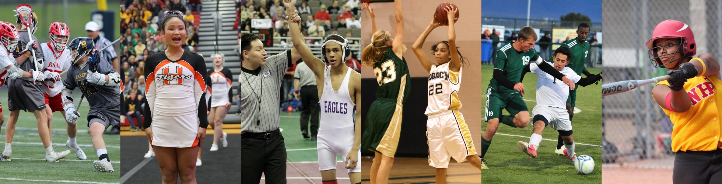
Thank You
National Federation of State High School Associations
PO Box 690 | Indianapolis, IN 46206
Phone: 317-972-6900
www.nfhs.org | www.nfhslearn.com | www.nfhsnetwork.com

